Slide 1
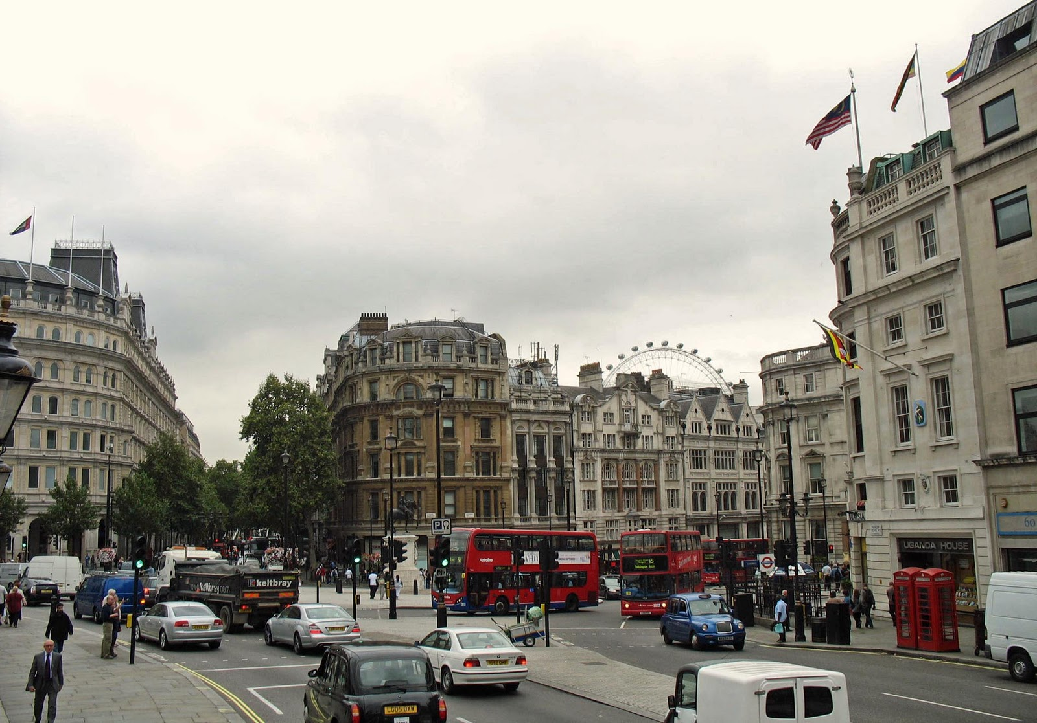
Analysis of London Airbnb Data

Slide 2
Data source
Search data set in Google
Download a few data sets to check whether it could be cleaned
Finally found a data set path in Kaggle
Data source: http://insideairbnb.com/

Slide 3
Data processing
Study the file
Neighourhood
Room type
Price
Minimum nights
Number of reviews
Last reviews

Slide 4
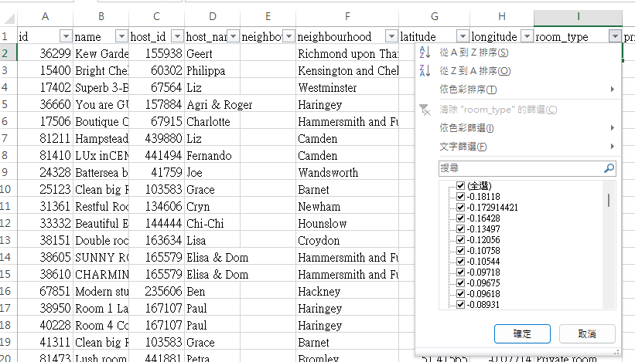
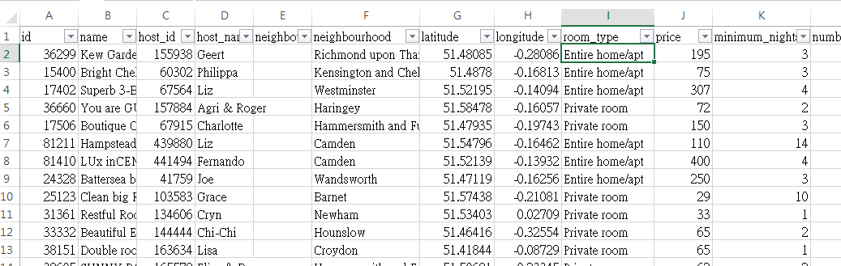
Data processing
Put the data to correct field
Remove data which may be difficult to be cleaned
Add news columns and create grouping (number of review, number of minimum nights, Inner/ Outer London) to the data

Slide 5
Analysis
Price and number of minimum nights
Price and number of review
Price and property type
Price and borough
Only use data with last review in 2021 and 2022, and price larger than 0

